Slide 1
CXI CHALLENGE
TICKET MANAGEMENT
STIMSON

Slide 2
Overview
KPI’s
Tools
Data Validation
Analysis
Conclusion
AGENDA
STIMSON

Slide 3
The data contains information about the 627 tickets that have been completed throughout the year 2021 by a team of 15 people. There are 24 columns of information for each ticket.
OVERVIEW
Notable columns in the data set are
Demographic
Category
Priority
Date of creation, picking, and completion
Assignee
VALIDATION

Slide 4





16 Days
Is the maximum
time taken to complete any type of ticket
4.1
Overall rating for the year 2021
45 states
around the USA have been worked on by our team with California at the top
KPI’S
Martina
Is the star performer for the year 2021
66%
Of the tickets are completed within 1 week
KPI

Slide 5







TOOLS
TOOLS

Slide 6


Proper data formatting
Created date <= Picked date <= Completed date
VALIDATION
The process used to ensure that data entered into a system is accurate, complete, and meets certain criteria or standards
627
Total tickets
raised in the year 2021
615
Valid Tickets
to be analyzed
VALIDATION

Slide 7
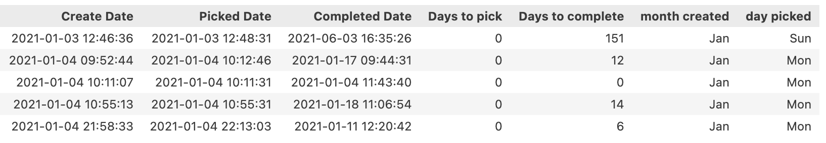
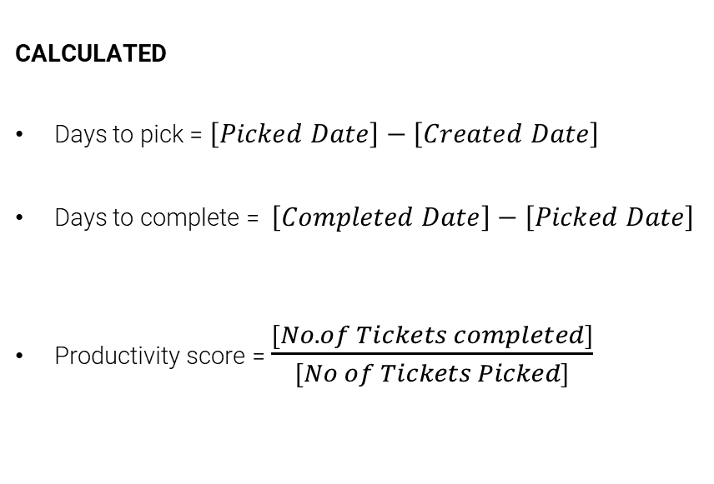
EXTRACTED
Created Date, Picked Date & Completed Date - Month & Days
CALCULATED
Days to pick = $\left[Picked Date\right]−\left[Created Date\right]$
Days to complete = $\left[Completed Date\right]−\left[Picked Date\right]$
Productivity score = $\frac{[No.of Tickets completed]}{[No of Tickets Picked]}$
DERIVED
<1 – Low productivity
=1 – Moderate productivity
>1 – High productivity
DERIVED/ PRE-PROCESSING

Slide 8




Trend
ANALYSIS
Category
Demographic
Assignee
ANALYSIS

Slide 9
WEEKLY TREND
CREATED
PICKED
COMPLETED
People tend to pick more tickets on Wednesday and complete more on Thursday
14% of the total tickets were created on weekends
Average weekly productivity score: 0.96
TREND ANALYSIS

Slide 10
MONTHLY TREND
CREATED
PICKED
Most of the tickets are picked and completed in the same month
No. of tickets created between Apr. – Jul. and Aug. – Oct. shows a down-trend but the productivity seems to be high
Drill-down Analysis
34 out of 81(~40%) of tickets completed in June were picked in the earlier months.
PICKED
COMPLETED
Average monthly productivity score: 1.01
TREND ANALYSIS

Slide 11
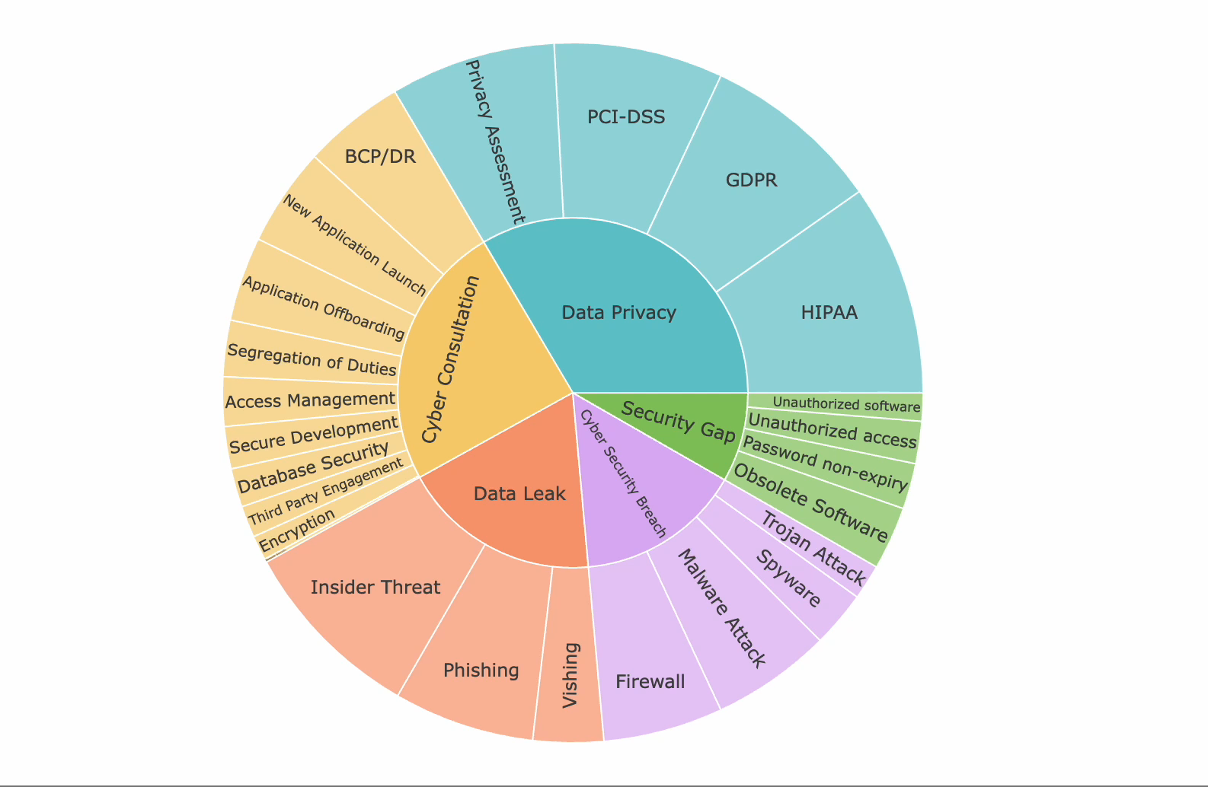
CATEGORY & SUBCATEGORY
50% of the tickets were based on Data Privacy and cyber consultation.
HIPPA is the most common type of ticket in the year 2021
Only 1 ticket has been created for New Security
https://bit.ly/Category_and_Subcategory
CATEGORY ANALYSIS

Slide 12
ABNORMAL TICKETS
Method used: IQR
Subcategory | Days to complete | Abnormal Tickets count
Obsolete Software | 163 | 4
Database Security | 115 | 1
Insider Threat | 109 | 13
Segregation of Duties | 108 | 2
BCP/DR | 105 | 4
PCI-DSS | 104 | 2
Third Party Engagement | 95 | 2
New Application Launch | 92 | 2
GDPR | 91 | 8
Phishing | 84 | 8
Application Offboarding | 79 | 4
Privacy Assessment | 77 | 8
Malware Attack | 76 | 6
HIPAA | 71 | 4
Spyware | 69 | 2
Access Management | 67 | 2
Vishing | 59 | 3
Trojan Attack | 54 | 2
Password non-expiry | 34 | 1
Firewall | 33 | 3
 | TOTAL TICKETS | 81
81 out of 615 (13%) tickets took around 1 – 5 months to be completed.
Possible reasons:
Incorrect completion date.
Lack of communication.
Interdependent on other teams.
Lack of technical expertise.
CATEGORY ANALYSIS

Slide 13
NORMAL TICKETS
COMPLETED
TICKET
After removing abnormal tickets, The average time taken to complete a Password non-expiry is more than a week
Drill-down Analysis:
Even with high-priority tickets for password non-expiry, it takes around 7 days to get completed
CATEGORY ANALYSIS

Slide 14
DEMOGRAPHIC
California, New York, Florida, Texas, and Virginia contributed to 50% of the tickets in the year 2021
DEMOGRAPHIC ANALYSIS

Slide 15
HIGH PRIORITY
# HIGH PRIORITY TICKETS
# TICKETS
More than 40% of tickets created from California and New York tend to be a high priority..
More than 55% - 65% of tickets were created from Florida, Texas, and Virginia tend to be high priority.
The top 5 states alone contribute to 156 out of 219 (71%) high-priority tickets created in the year 2021
Drill-down analysis:
83% (10/12) of the tickets created by Michigan are high-priority tickets
DEMOGRAPHIC ANALYSIS

Slide 16
INDIVIDUAL CONTRIBUTION
Martina, Allan, Charles, Robin, and Bob, Cinderalla are the top 6 contributors.
These top 6 contributors completed 57% of tickets created.
Drill-down analysis:
Aleena contributed 4% to the team and had a lowest productivity score of 0.70.
In some months she has picked or completed 0 tickets
ASSIGNEE ANALYSIS

Slide 17
LOW RATED TICKETS
PERCENT OF TICKET (Low Rated)
96 out of 615 (15%) of the total tickets have received a low rating i.e., Unsatisfactory (rating = 2)
7 out of 25 (28%) of the tickets completed by Sebastian received a low rating i.e., Unsatisfactory (rating = 2)
Drill-down analysis:
Out of 96 low-rated tickets the major sub-category
Insider threat(11)
New Application Launch(10)
HIPPA(10)
Phishing(10)
PCI-DSS(9)
ASSIGNEE ANALYSIS

Slide 18
CONCLUSIONS
Tickets were created less during the months of Feb, Mar, Oct and Nov. We can involve the team in the training/ KT for the sub-category with a low customer rating
As we receive more tickets based on data privacy and cyber consultation. We can request our development team to improve the data handling in our products
We can train our low performing individuals to increase your rating and customer satisfaction
Better representation:
We can improve analysis by shifting from days of completion → Hours of completion to find the tickets that truly take longer time to complete.
A new data table that contains the total experience, years of service in the company/team, and expertise of an individual can help us measure their impact on a ticket.
CONCLUSION

Slide 19
Q&A
Python workbook
Dashboard
STIMSON

Slide 20
THANK YOU
STIMSON

